Slide 1

Lending Club Case Study
Prasanta Bhattacharjee
Batch MLC70

Slide 2
Background
The company faces significant financial losses due to loan defaults. By analyzing the characteristics of borrowers who default, the company aims to develop a predictive model to identify high-risk loan applicants and mitigate potential credit losses.

Slide 3
Objective
The primary objective of this case study is to identify the key driver variables that contribute to loan default, enabling the company to reduce credit loss and improve its risk assessment process.

Slide 4
Approach of Analysis
The dataset includes information on borrower characteristics, loan attributes, and loan outcomes (e.g., default or repayment).
The specific variables are Home ownership, employment length, purpose, etc.
Loan attributes: loan amount, interest rate, term, etc.
Loan outcomes: default (charged-off) or repayment (fully paid or current)
By applying EDA and statistical modeling techniques to this dataset, the company can gain valuable insights into the factors driving loan default and develop a more effective risk assessment process.

Slide 5
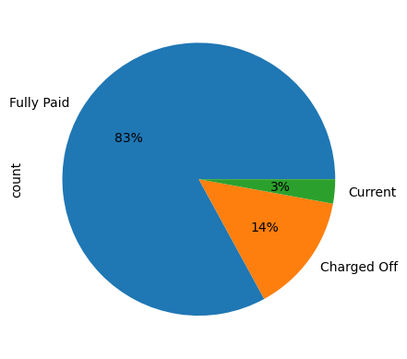
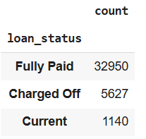
Data Understanding
Overall Default Rate is 14%
i.e., Ratio of “Charged Off” cases with respect to overall cases.
The “Current” ones, i.e., active loan application cases can be excluded from the analysis as these are neither closed or defaulter cases, and also significantly less in comparison to overall records in the dataset.

Slide 6
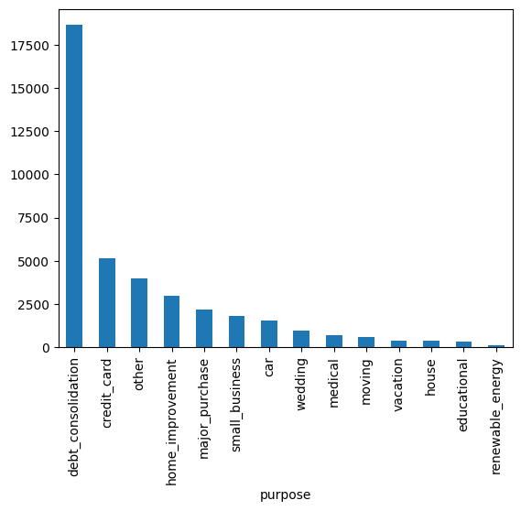
Loan Purpose Distribution
Debit consolidation most popular purpose.
It will be necessary to investigate further on default rates of each of the purposes.

Slide 7
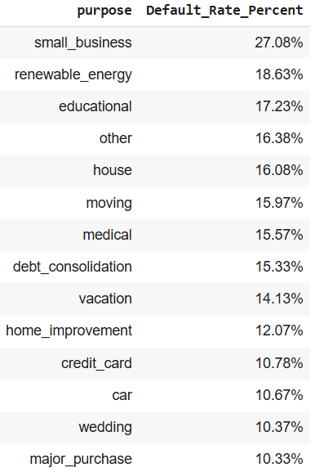
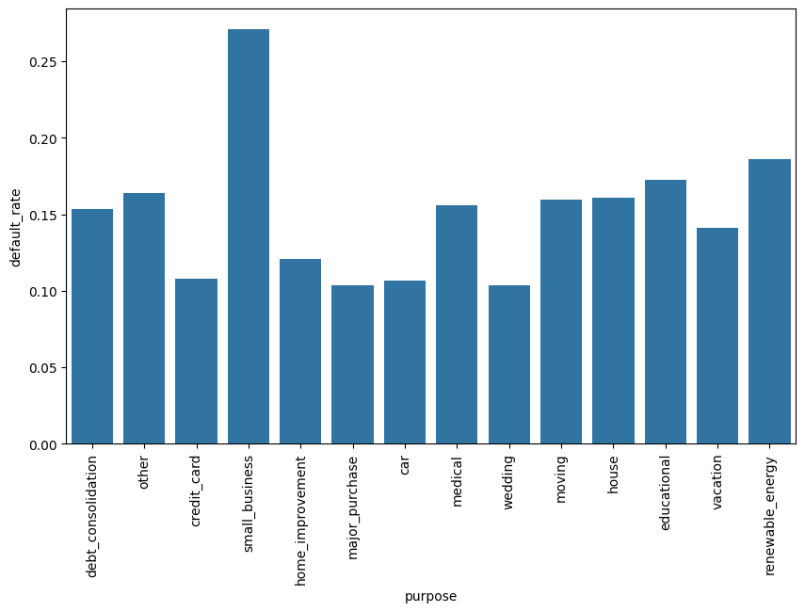
Default Rates by Loan Purpose
Applications with Small Business Purpose have the highest Default rate.

Slide 8
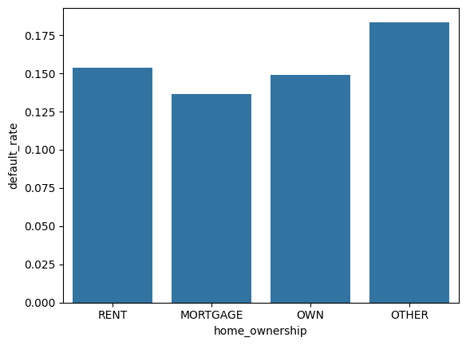
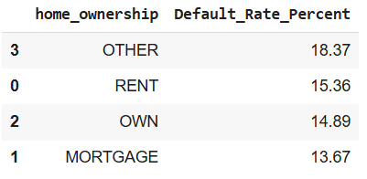
Home Ownership – not a determinant feature
It can also be observed that Home Ownership does not give any strong indication.

Slide 9
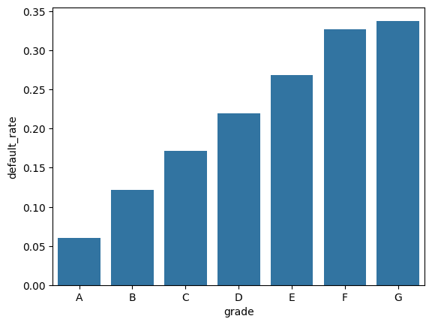
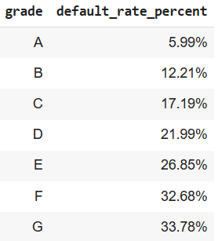
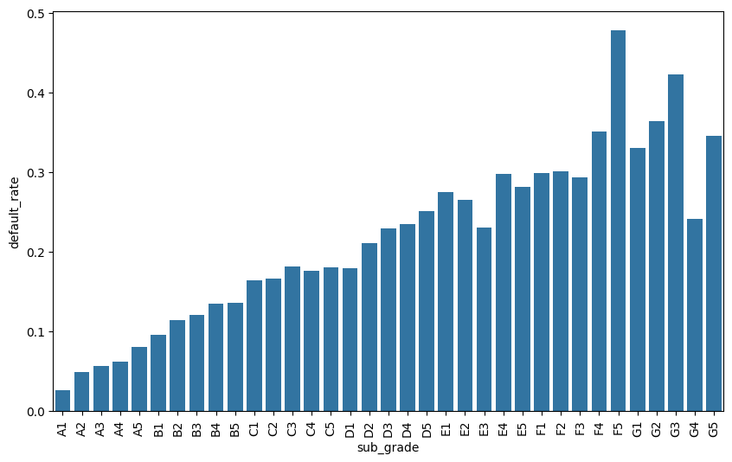
Grade & Sub Grade Distribution
It can be observed that the grades are assigned by LC on the basis of the default rates. Default rate is lowest for Grade A whereas highest for Grade G . Similar pattern can be seen for sub grades however with some exceptions as can be visualised in the chart below.

Slide 10
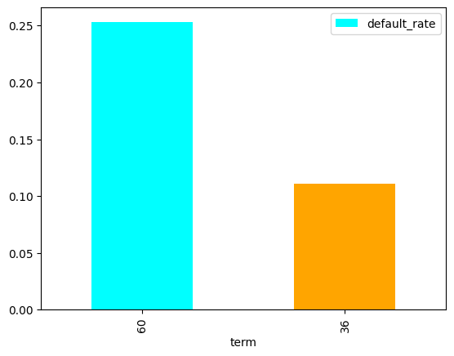
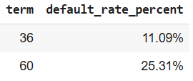
Term Feature Observations
The application terms have only 2 categories:
36 months
60 months
It can be observed that 60 months applications have higher default rate.

Slide 11
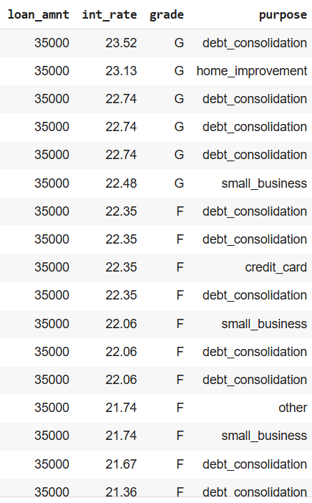
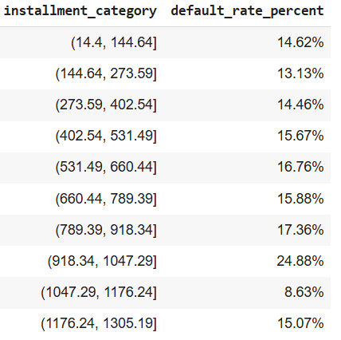
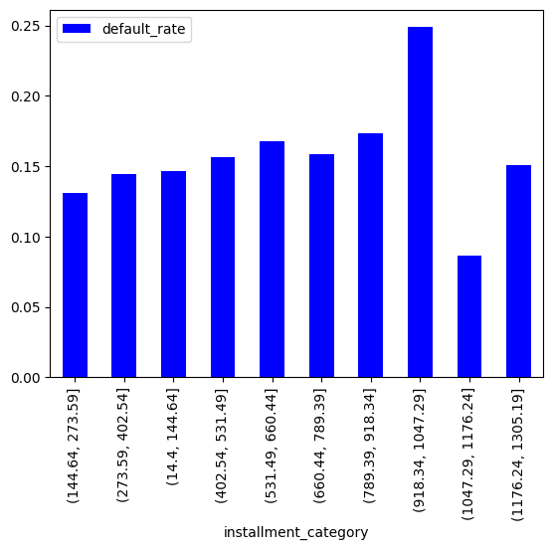
Instalment
It can be observed that there is slight increase in default rate for instalment within the range of approximately 900 to 1000. Upon drilling down further into this category it was found that interest rates and loan amounts were comparatively much higher for defaulter cases.

Slide 12
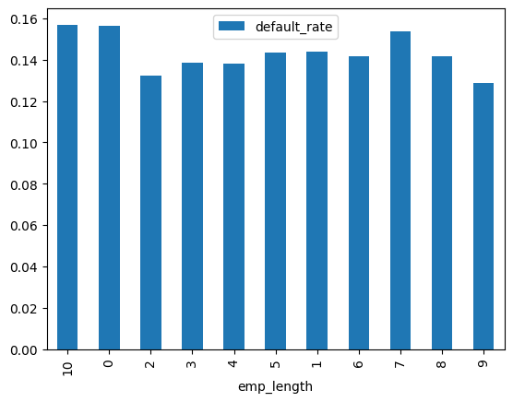
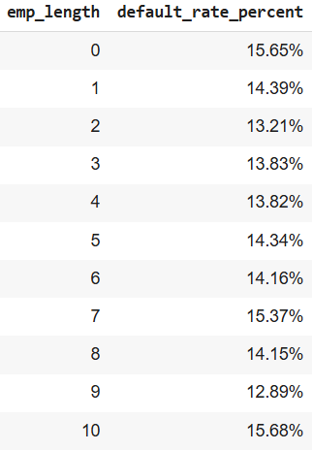
Employment Length
Employment length is not a determinant feature.

Slide 13
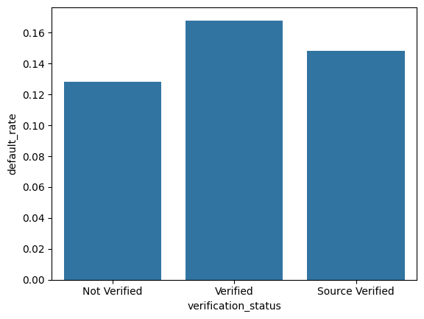
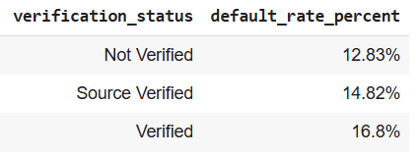
Verification Statuses
There is a possibility of some fraudulent cases because rate of defaulters is observed to be more for verified cases than non verified cases. These labels cannot be relied upon for risk analysis.

Slide 14
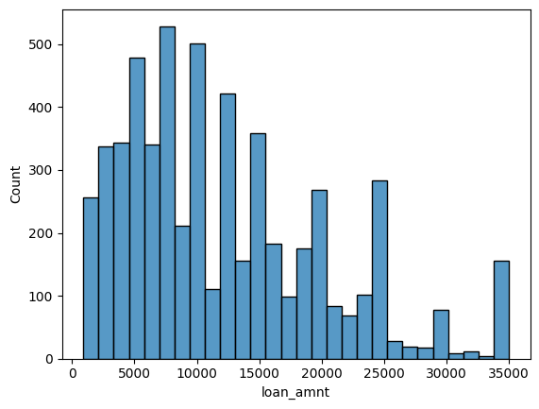
Loan amounts
There is no distinct pattern observed with respect to the loan amounts as well.

Slide 15
Recommendation
Based on the discussed findings and features identified such interest rate, loan amount, purpose of loan, etc., development of a predictive model will be necessary to estimate the likelihood of default based on borrower and loan characteristics.
The relevant numeric features should be used to generate the training and test datasets and then predictions can be obtained from the model.

Slide 16
Thank You

